Slide 1
Actionable Messages for Outlook
Praveen Chandran | Pankaj Pal

Slide 2
Agenda
Introduction/Overview
Success Stories
Recommended Scenarios/Use Cases
How Do Actionable Messages work on Outlook
How to Build and Publish Actionable Emails

Slide 3
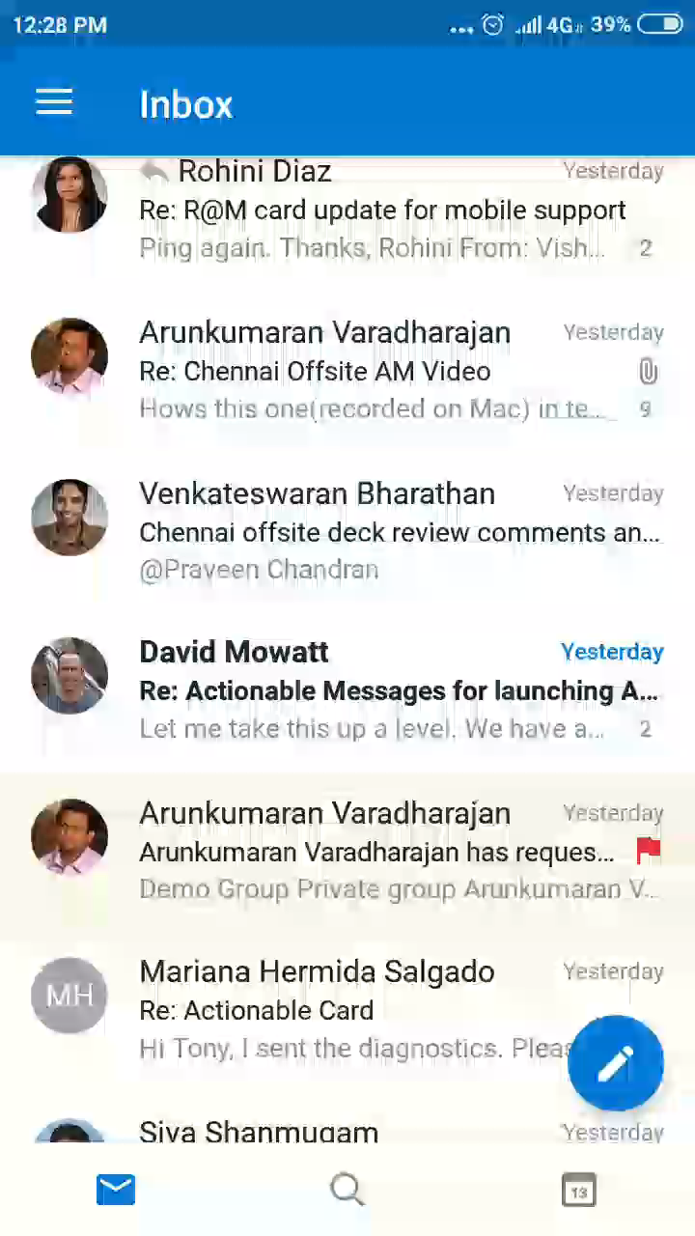
Actionable Messages on Outlook
Actionable Messages enable you to take quick actions right from within an email
Top Use Cases currently available
Microsoft 1st Party : Unified Groups (access approval), SharePoint (access approval), MS Flow (workflow approval), MS Expense (expense approval)
3rd Party Partners : Tinypulse (poll), Nintex (workflow automation), Service Now (Purchase approval, Feedback Survey), Freshworks (Customer support), Sage (timesheet approval)
Coming Soon
Microsoft 1st Party : Reply At Mention, Teams Missed Activity (collaboration), My Analytics (Productivity suggestions)
3rd Party Partners : Survey Monkey (feedback survey), Wrike (collaboration)
100+ 1p/3p/Line of Business use cases are currently live
Demo – Teams Missed Activities

Slide 4
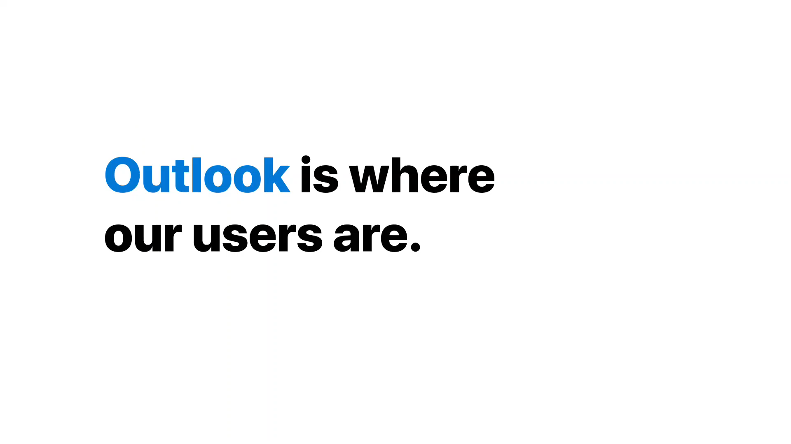

Actionable Messages on Outlook
Notes:
[ 1 min 05 secs ]

Slide 5
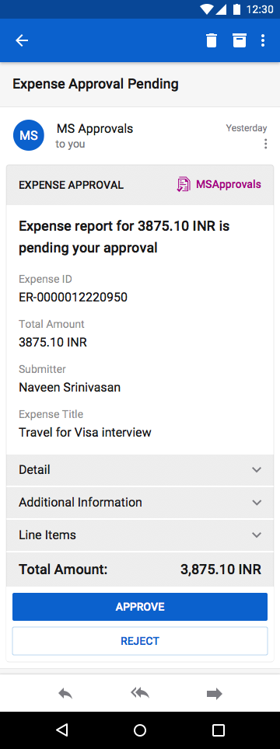
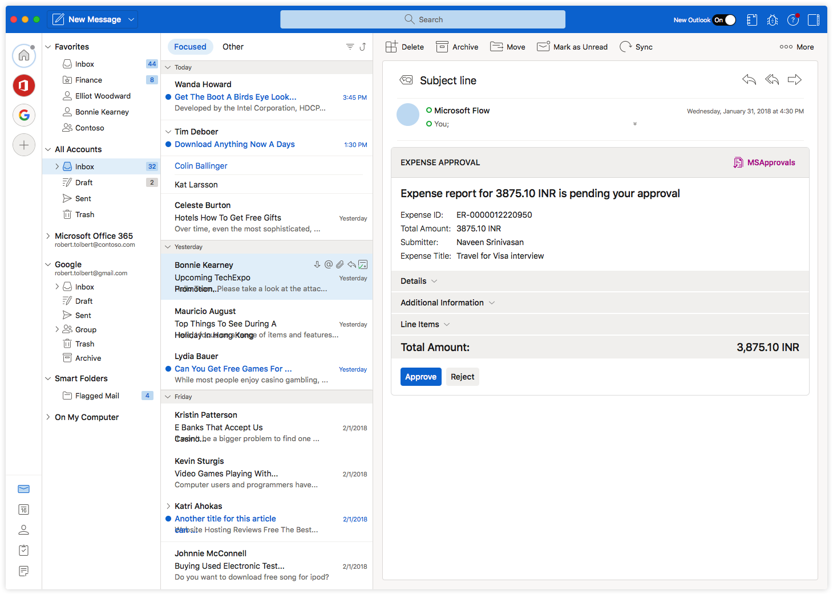
Design Once & Deploy Seamlessly on all Outlook Clients

Slide 6
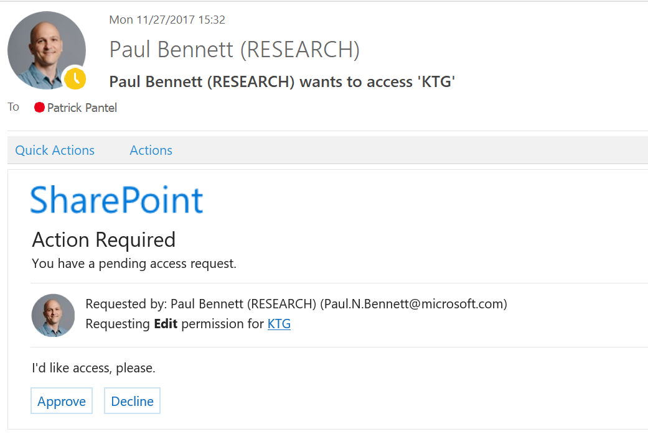
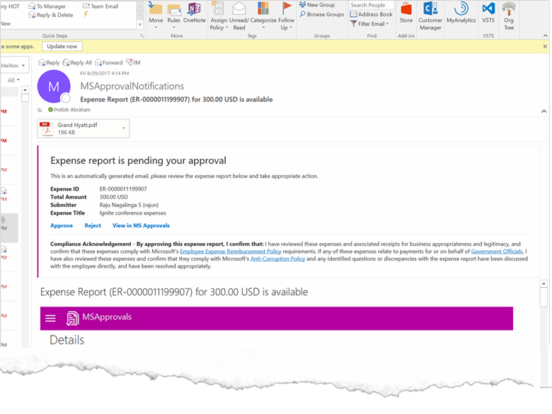
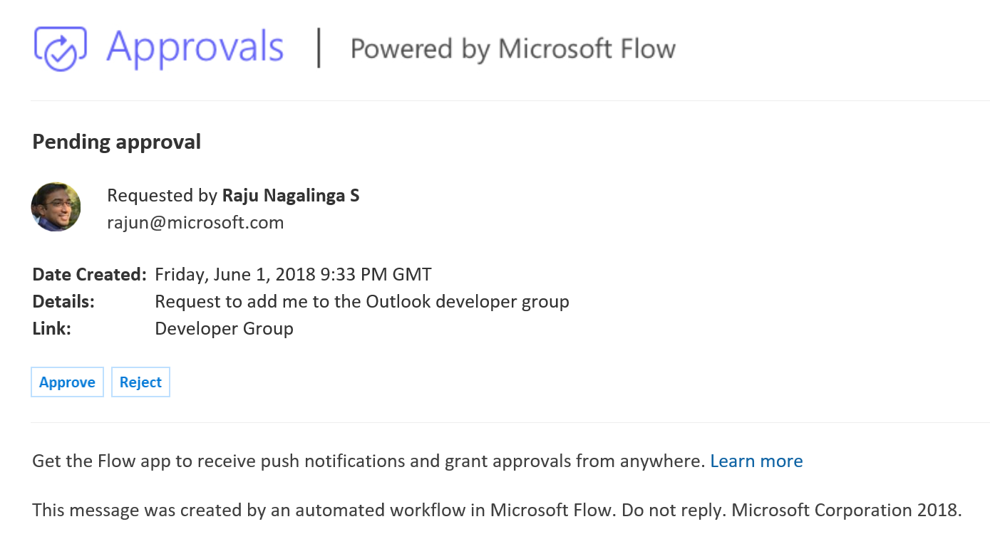
Success Stories
SharePoint Access Approval
More than 3 million approval emails Over 3M emails every month & still growing
Faster time to act than legacy e-mails Used to take 48 hours, now within 30 minutes Greater engagement Around 40% of access request cards that are viewed are acted upon
Microsoft Expense Approval
$$$ Savings & faster time to act Huge improvement in time-to-approve from 6 days to within 17 hours (at 85th %le). Estimated $8M saving incl late fees
Scales to other approval flows (ROI) Microsoft IT has expanded the integration to more products covering purchase orders, vendor invoicing and vacation approval (in development) scenarios
Magical experience “I just got an expense actionable message and it was MAGICAL. Good stuff”
Approvals via Microsoft Flow
Top IT developer tool
Most used Flow template (consistently in top 5)
Powers line of business workflows
3M+ approval requests every month.
Used by ~3,000 large Office 365 tenants
Microsoft Flow

Slide 7
Top Scenarios
Here some of the top scenarios where an Actionable Message can add value
Approval :
Leave requests, Access requests, Membership requests, Expense, Purchase, Timesheet, Shift Change/Swap
Collaboration :
Commenting/Discussions, Status Change, Assign/Un-assign
CRM (Sales/Lead Management) :
Assign/Un-assign, Tags, Manage Appointments, Status change
Feedback :
Support/Helpdesk, Hotel Experience, Flight Experience, Product Feedback
Subscription :
Manage subscription, Follow/Unfollow/Mute
* Please note that this is not an exhaustive list of scenarios

Slide 8
How Can you Build Actionable Emails?

Slide 9
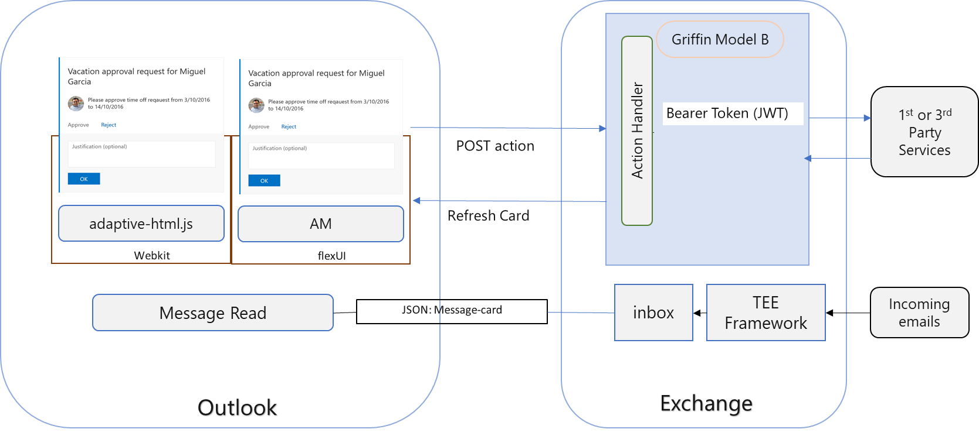
How Outlook Actionable Emails Work
Core components of an “Actionable Message”:
Partner’s email service registered as an approved sender on Actionable Emails
Partner’s service endpoint exposed to Office 365
Office Action Execution Agent (Action Handler)
Client-side rendering at Outlook end points

Slide 10
How to go about building Actionable Message?
Identify Scenario
Approval/Rejection
Design actionable message card for all Outlook Clients
Designer Tool (https://aka.ms/amdesigner)
Register as a partner
Register at https://outlook.office.com/connectors/oam/publish
Collaboration/Workflow : Status change, commenting etc.
Feedback
Preview for wide screen and mobile
Send card to yourself
Develop AM as “Test User” with your feature crew
Register with Organization/Global scope when ready
Go live – send AM from your email service with your originator ID
Developer documentation
Sending actionable messages via email - https://docs.microsoft.com/en-us/outlook/actionable-messages/send-via-email
Here’s a quick example - https://github.com/OfficeDev/HelloActionableMessages
Security considerations - https://docs.microsoft.com/en-us/outlook/actionable-messages/security-requirements
Who needs to approve for taking your actionable message scenario live
Tenant admin is the approver if your scenario scope is “Organization” i.e. recipients will be from your company only
An approval from Microsoft is required to take the scenario live for “Global” scope
Microsoft Flow is a quick and simple way to on-board to Outlook Actionable Messages for approval scenarios

Slide 11
Thank You!
Got questions? Reach out at onboardoam@Microsoft.com
Developer documentation : https://docs.microsoft.com/en-us/outlook/actionable-messages

